Slide 1



SmarTunes:
Listening to your Air Conditioner
Project of:
Muhammad Saad Abdullah

Slide 2

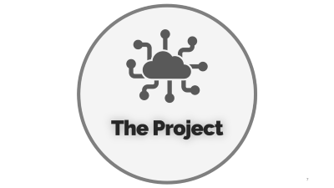
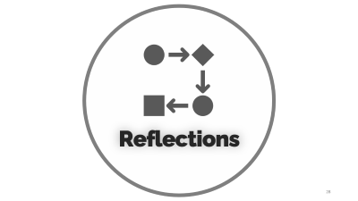
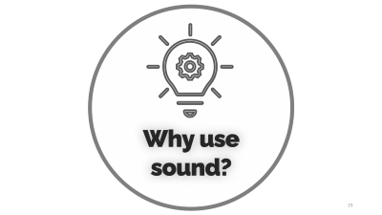
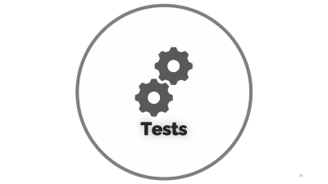

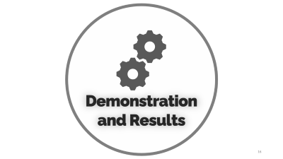
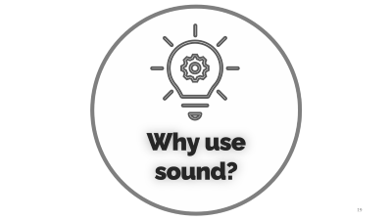
SmartTunes:
Listening to your Air Conditioner
Project of:
Muhammad Saad Abdullah
Project Advisors:
Muhammad Sufyan Vohra
SmarTunes:
Listening to your Air Conditioner
Notes:
https://unsplash.com/photos/AXu2aZ3YgP8

Slide 3

Introduction

Slide 4



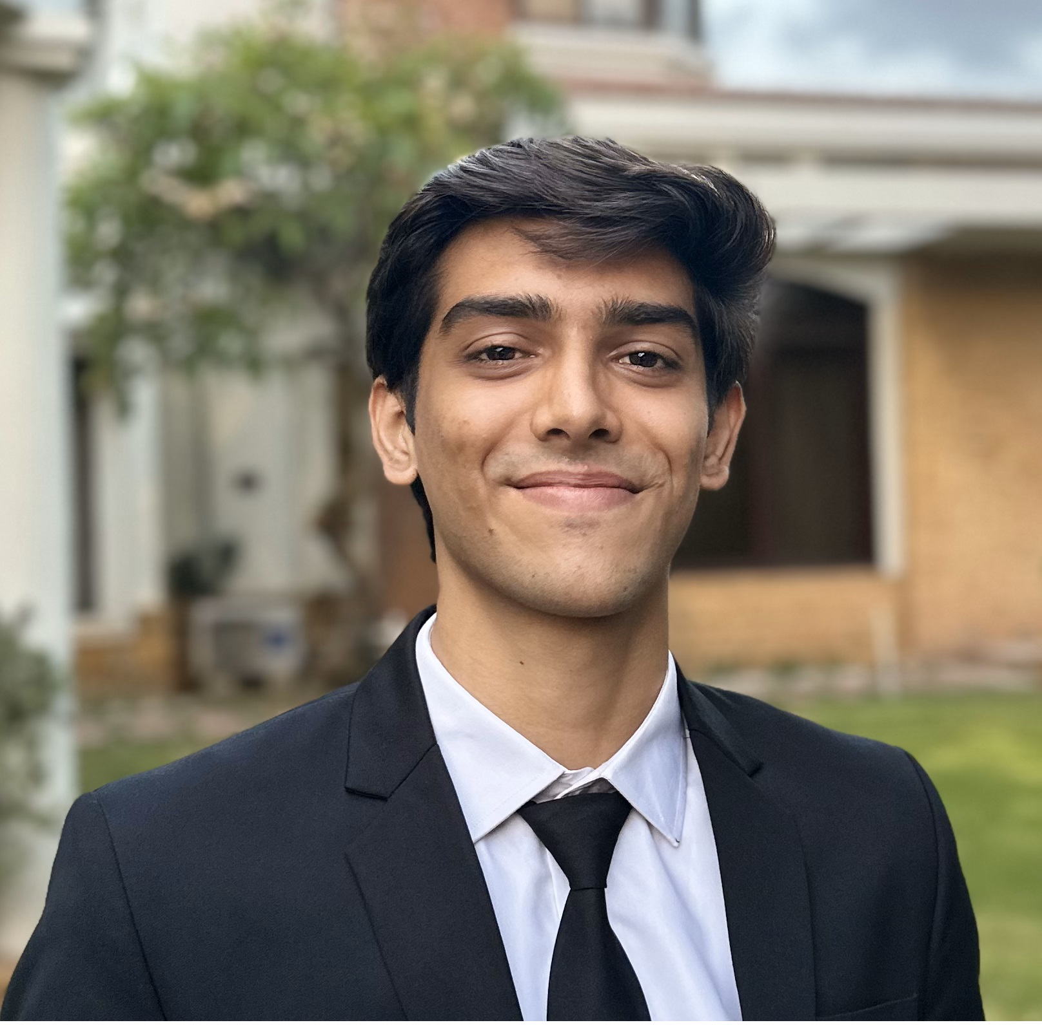
Introduction
Hello, Everyone!
I am Saad Abdullah
I am delighted to have been given the opportunity to kickstart my career with Dawlance.
Electrical Engineering Graduate from NUST
Avionics Department lead at NUST Rocket Team
Enthusiastic problem solver with a passion for leveraging technology to drive change
Contributed to Innovative AC Projects
Notes:
https://unsplash.com/photos/TvN54bnuQg8

Slide 5

Problem
Identification

Slide 6


Problem Identification
The Solution
The Problem
Traditional air conditioning data retrieval involves time-consuming and labor-intensive processes, requiring disassembly and the use of complex monitoring devices. This method leads to increased maintenance costs, potential user inconvenience, and troubleshooting delays.
Develop an innovative transmission system to simplify data retrieval, providing real-time insights for optimized maintenance and enhanced user experience
Notes:
https://unsplash.com/photos/fItRJ7AHak8

Slide 7

The Project

Slide 8
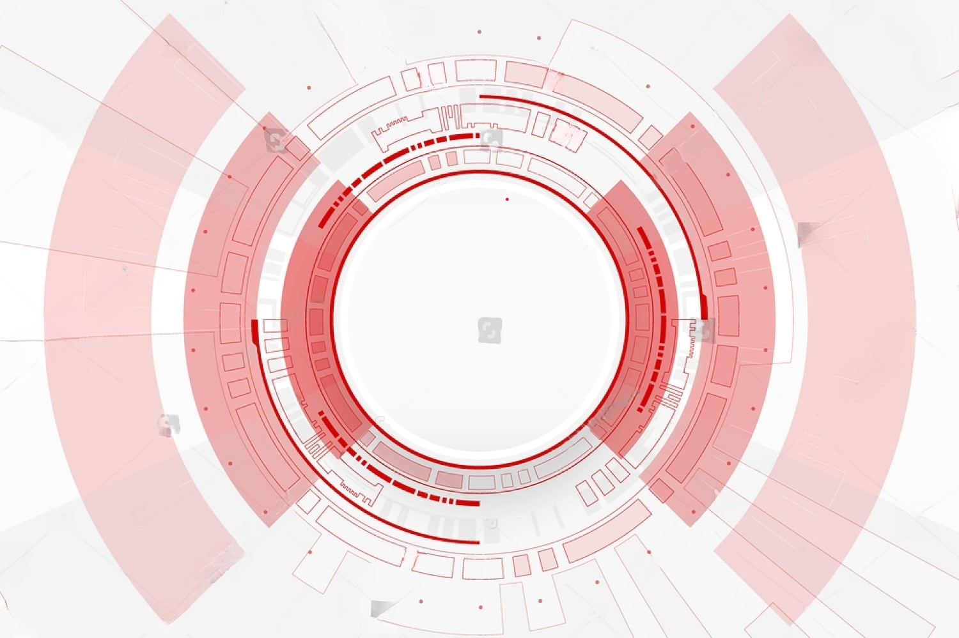
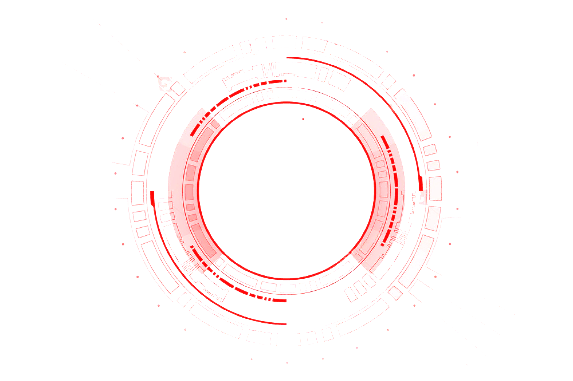

Project Scope
Backend
System Design
Frontend App
Design
Testing
Data Transfer
Protocol Design
Notes:
https://unsplash.com/photos/TvN54bnuQg8

Slide 9
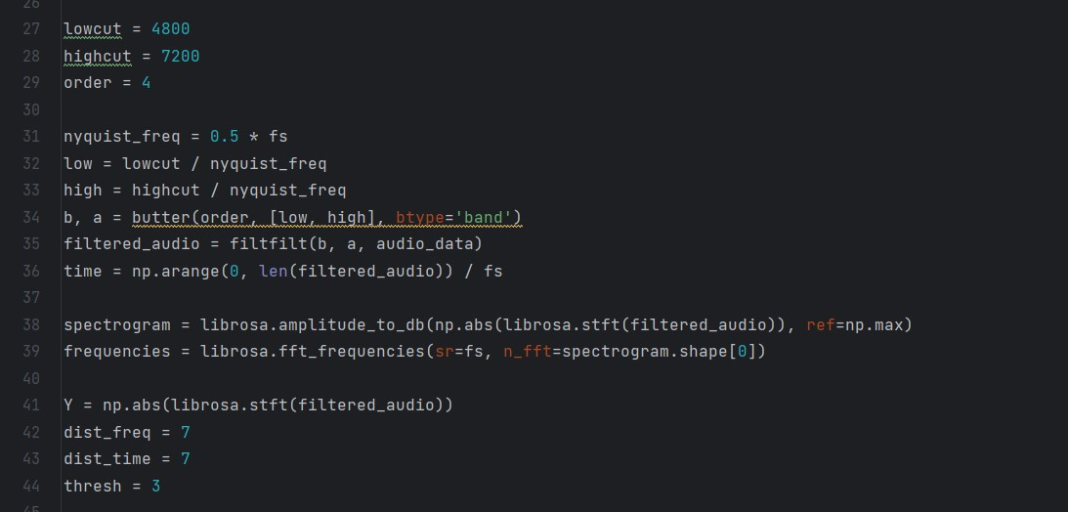
Backend
System Design
Creating a sophisticated algorithm for processing, and interpreting of audio signals
Implementing signal processing techniques, noise filter algorithm, and accurate data extraction mechanisms
Notes:
https://unsplash.com/photos/TvN54bnuQg8

Slide 10
Project Scope
Backend
System Design
Frontend App
Design
Testing
Data Transfer
Protocol Design
Notes:
https://unsplash.com/photos/TvN54bnuQg8

Slide 11
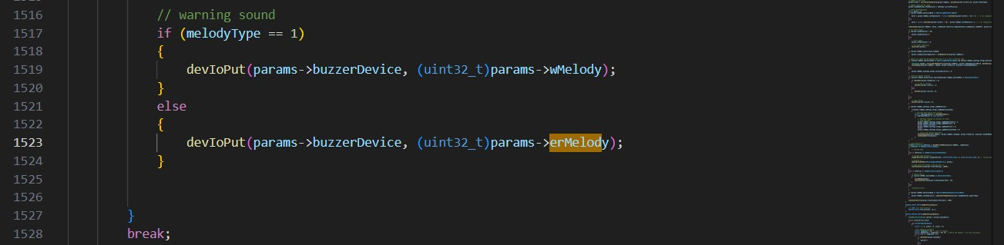
Data Transfer
Protocol Design
Develop a robust protocol for efficient audio signal and data transmission between the air conditioner and the receiver
Ensure secure, reliable, and real-time communication across various environments
Notes:
https://unsplash.com/photos/TvN54bnuQg8

Slide 12
Project Scope
Backend
System Design
Frontend App
Design
Testing
Data Transfer
Protocol Design
Notes:
https://unsplash.com/photos/TvN54bnuQg8

Slide 13
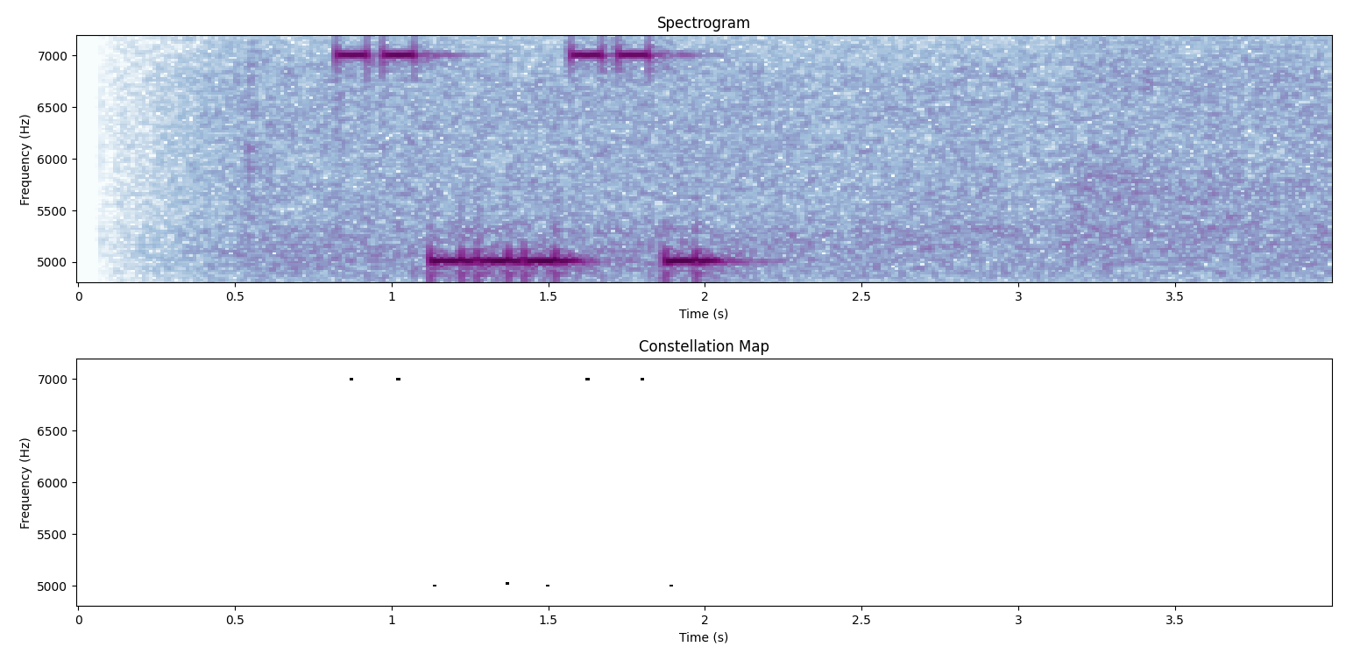
Testing
Integrate backend algorithms, data transfer protocol, and hardware components into a cohesive system
Conduct rigorous testing to validate accuracy, reliability
Address synchronization and compatibility issues for smooth data flow
Notes:
https://unsplash.com/photos/TvN54bnuQg8

Slide 14
Project Scope
Backend
System Design
Frontend App
Design
Testing
Data Transfer
Protocol Design
Notes:
https://unsplash.com/photos/TvN54bnuQg8

Slide 15
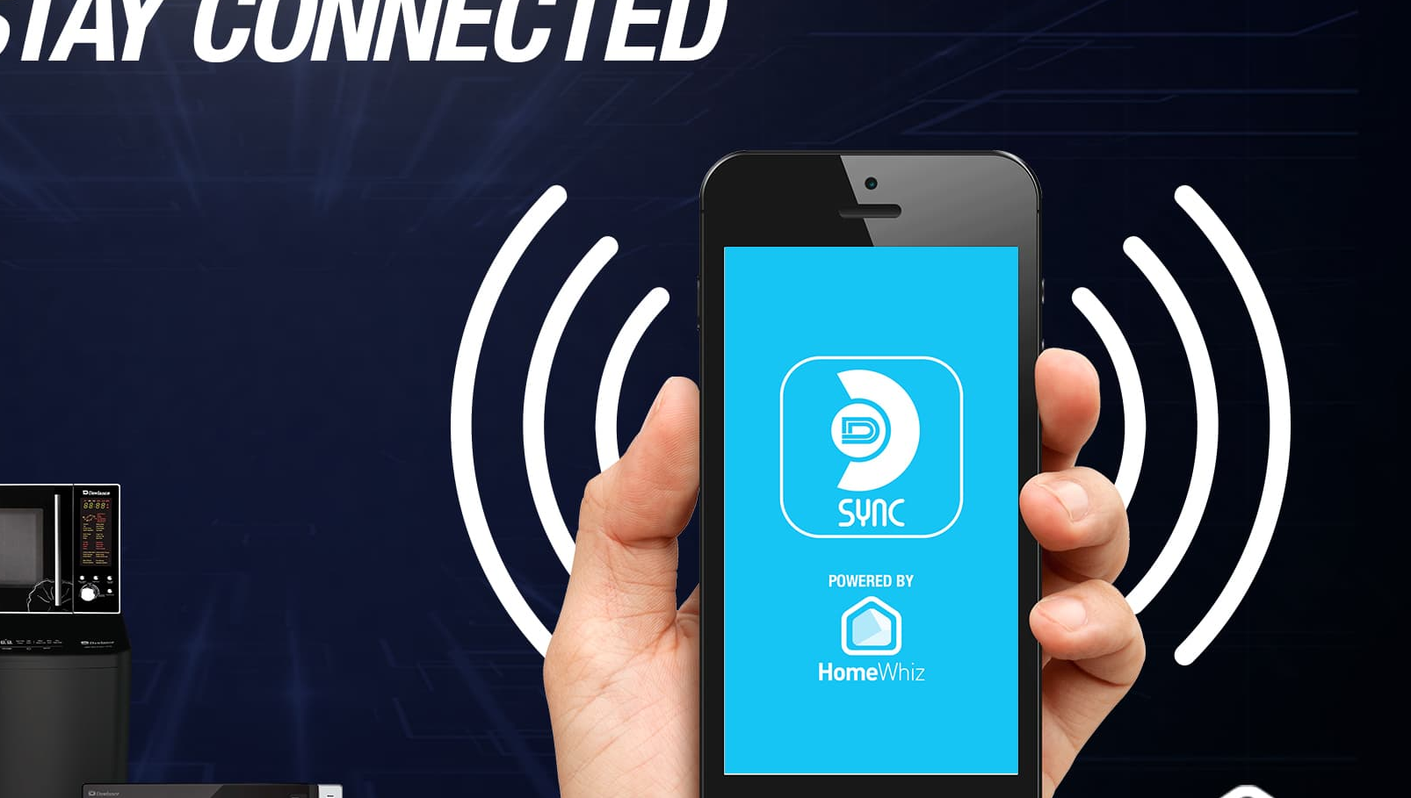
Frontend App
Design
Design an intuitive graphic user interface (GUI) for an app to present real-time data insights
Notes:
https://unsplash.com/photos/TvN54bnuQg8

Slide 16

Demonstration and Results

Slide 17
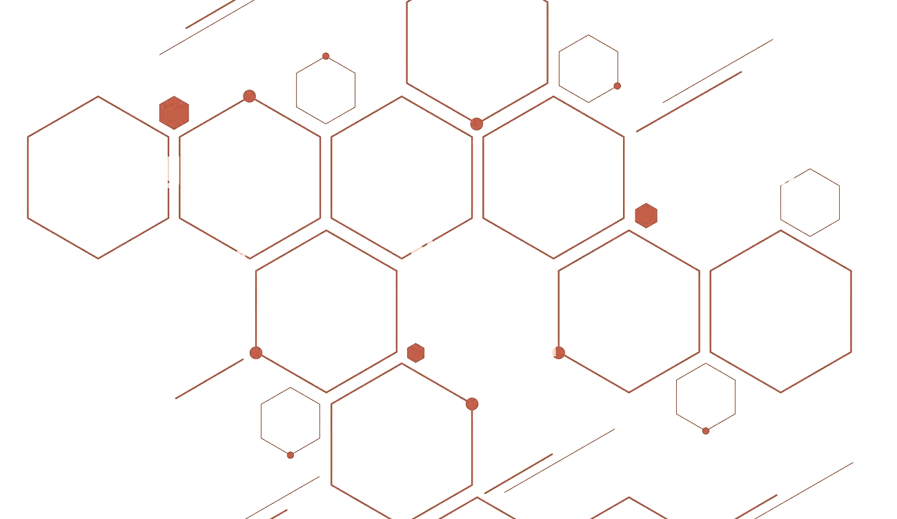

Current Set-up
Picture removed for privacy.
Notes:
https://unsplash.com/photos/fItRJ7AHak8

Slide 18
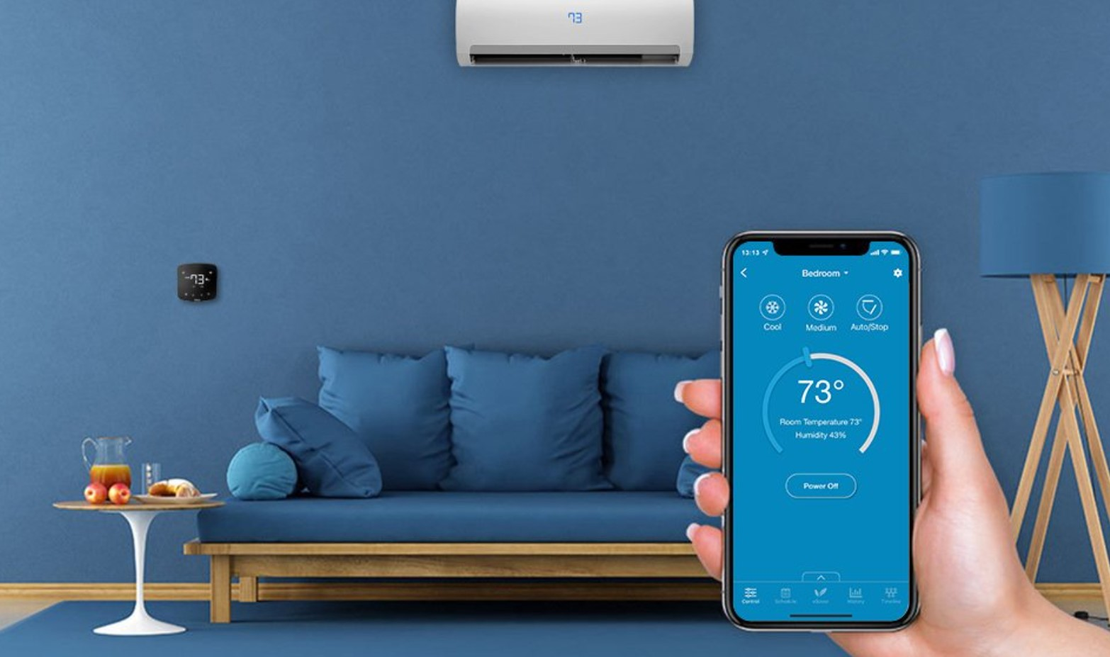
Proposed Solution
Notes:
https://unsplash.com/photos/fItRJ7AHak8

Slide 19
Video Demonstration
Video removed for privacy.
Notes:
https://unsplash.com/photos/fItRJ7AHak8

Slide 20

Test Results
Notes:
https://unsplash.com/photos/fItRJ7AHak8

Slide 21

Why use
sound?

Slide 22



Why use sound?
2
4
Non-Destructive Data Collection
Remote Monitoring
Monetary Value
1
Cost-Effective Solution
3
Universality and Compatibility
5

Slide 23
Why use sound?
Non-Destructive Data Collection
2
4
Remote Monitoring
Monetary Value
Sound-based data retrieval eliminates the need for disassembling air conditioners
1
Cost-Effective Solution
3
Universality and Compatibility
5

Slide 24
Why use sound?
2
4
Non-Destructive Data Collection
Remote Monitoring
Monetary Value
The necessary components are already installed and in use, hence there are no excess material costs
1
Cost-Effective Solution
3
Universality and Compatibility
5

Slide 25
Why use sound?
2
4
Non-Destructive Data Collection
Remote Monitoring
Monetary Value
Sound-based data retrieval allows remote monitoring of air conditioner performance
1
Cost-Effective Solution
3
Universality and Compatibility
5

Slide 26
Why use sound?
2
4
Non-Destructive Data Collection
Remote Monitoring
Monetary Value
Sound based system is not limited to a specific air conditioner model. All models come with a built-in piezoelectric buzzer.
1
Cost-Effective Solution
3
Universality and Compatibility
5

Slide 27
Why use sound?
2
4
€14,000
Non-Destructive Data Collection
Remote Monitoring
Monetary Value
The company saves over fourteen-thousand euros spent on equipment necessary for data monitoring, which cost around €150 per unit.
1
Cost-Effective Solution
3
Universality and Compatibility
5

Slide 28

Reflections

Slide 29





Timeline
Week 1-2
Week 5-6
Week 3-4
Notes:
https://unsplash.com/photos/GKLIsLZxhj0

Slide 30
Timeline
Week 1-2
Conducted in-depth research on the problem at hand and related algorithms
Familiarized myself with the codebase
Engaged in discussions with the team to gain insights into project objectives and requirements
Notes:
https://unsplash.com/photos/GKLIsLZxhj0

Slide 31
Timeline
Week 3-4
Refined the existing code to incorporate data transmission over sound
Developed an algorithm for efficient data retrieval
Notes:
https://unsplash.com/photos/GKLIsLZxhj0

Slide 32
Timeline
Week 5-6
initial testing and identification of areas for further enhancements
Recorded and documented results for analysis
Prepared a comprehensive project presentation
Notes:
https://unsplash.com/photos/GKLIsLZxhj0

Slide 33
Personal Growth
An opportunity to deepen my technical skills
Insights into the workings of an industry-leading company
Overcoming challenges and contributing to a project boosted my self-confidence
Got to engage in lunch hour conversations with established professionals helping me to plan my future better
Developed lasting mentorship relationships with colleagues
Notes:
https://unsplash.com/photos/GKLIsLZxhj0

Slide 34
Conclusion
In summary, my time at Dawlance has been a transformative journey of technical growth and personal development. From contributing to the project to forming lasting relationships, I am grateful for the valuable experiences and insights gained.
As I step forward, I carry with me the confidence and passion to excel in future endeavors.
Notes:
https://unsplash.com/photos/GKLIsLZxhj0

Slide 35
THANK YOU
FOR YOUR TIME!
Notes:
https://unsplash.com/photos/GKLIsLZxhj0

